Slide 1
Capstone Project - The Battle of Neighborhoods - Final Project Report
By Ratnesh Mehrotra

Slide 2
Objective
Come up with suggestions on locations of theatres which can be shortlisted for screening of the Indian movie in New York City

Slide 3
Data Set Analysed
Boroughs and their Neighbourhoods, with their GeoCodes
Following popular venues in each neighbourhood:
Movie Theater
Indian Restaurant
Chinese Restaurant
Shopping Mall
Data Source
NYU Spatial Data Repository
FourSquare APIs

Slide 4
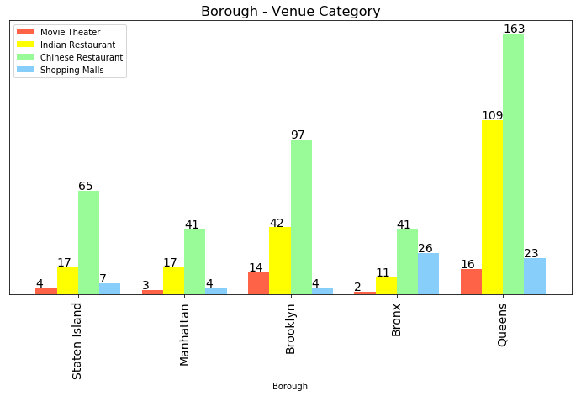
Understanding the Data Set
Number of each category in each Borough

Slide 5
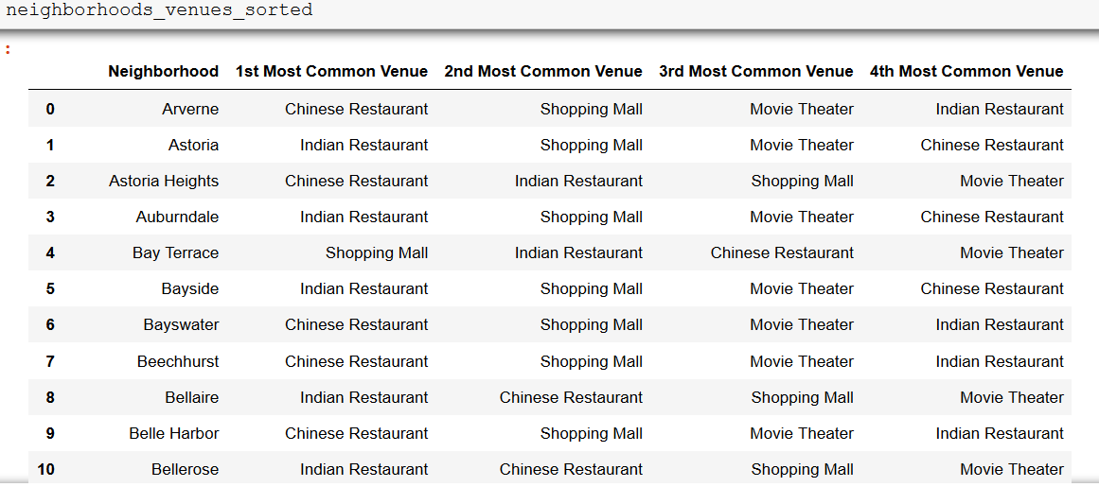
Understanding the Data Set
Common Venues in each neighbourhood, sorted in descending order of popularity

Slide 6
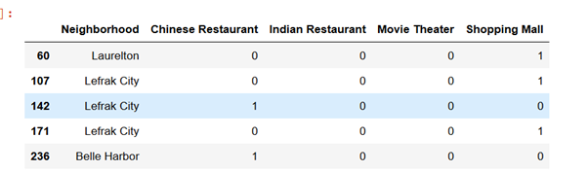
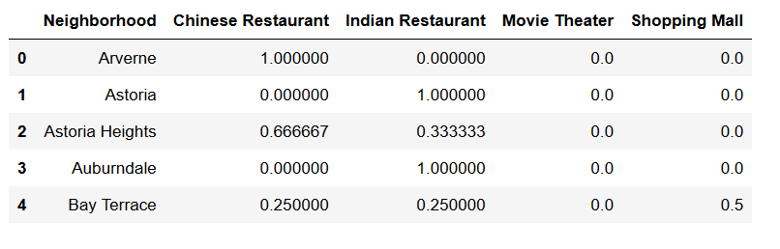
Preparing the Data Set
Hot encoded to convert the categorical values into integer values
Mean of the frequency of occurrence of each category

Slide 7
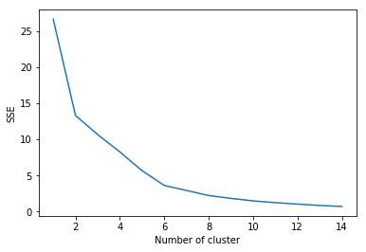
Modelling Approach
Since the solution to problem lies in realm of identification of groups of neighbourhoods in a borough having Theatres, Restaurants and Shopping Malls, clustering modelling technique was selected to be most appropriate.
k-means algorithm was selected as the clustering algorithm.
Graph of SSE versus K-count was plotted to determine optimum value of K
A k-value of 6 was selected
A k-value of 6 was selected

Slide 8
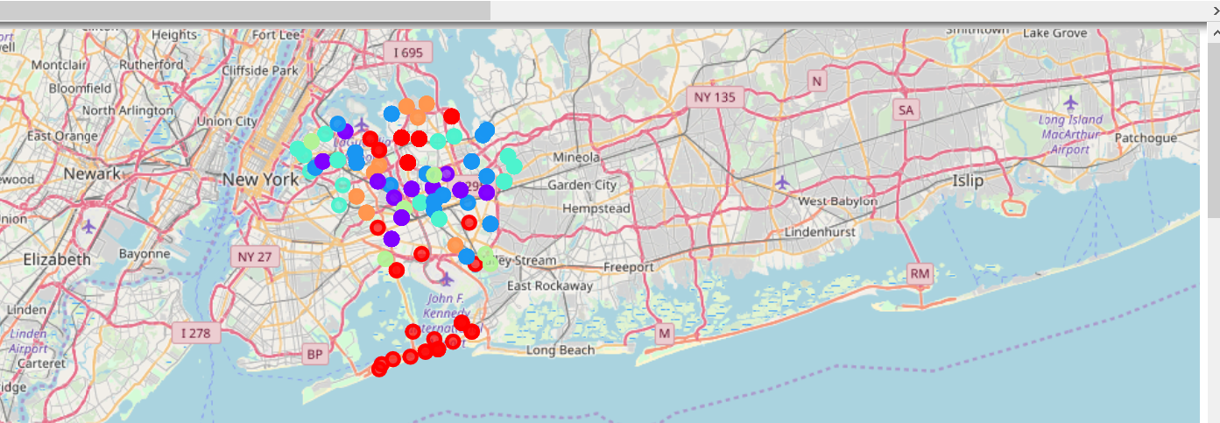
Output of Model
Clusters in Queens Borough plotted on NYC Map

Slide 9
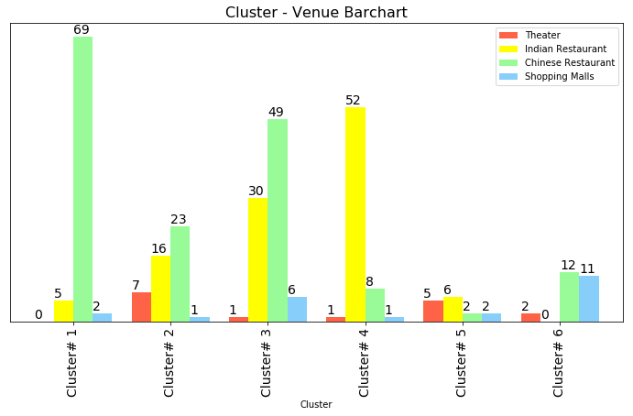
Results
Cluster #1 does not show any Movie Theater and hence can be discarded from consideration
Clusters #2 and # 4 do have good number of Indian and Chinese Restaurant but only one shopping mall each. If the movie screening happens to be during festival seasons, when malls offer good promotional offers, viewers may want to explore more than one mall and may prefer theaters located in vicinity of many shopping malls
Cluster #3 and #5 have all the venue categories of interest. These clusters include more than one restaurants and malls, and can be shortlisted
Cluster #6 does not show any Indian restaurant and hence theatres located in that region may not be popular with the movie goers
Composition of each cluster

Slide 10
Result
Cluster # 3:
Movie Theater: AMC Fresh Meadows 7
Neighbourhood: Pomonok
Popularity CR > MT> SM > IR
Legend
MT: Movie Theater IR: Indian Restaurant
CR: Chinese Restaurant SM: Shopping Mall
Cluster # 5:
Movie Theater: Cinemart Cinemas, Kew Gardens Cinema
Neighbourhood: Kew Gardens
Popularity : IR > MT > SM > CR
Cluster # 5:
Movie Theater: Linden Boulevard Multiplex Cinemas
Neighbourhood: Lindenwood
Popularity : MT > CR> SM > IR
Cluster # 5:
Movie Theater: AMC Fresh Meadows 7
Neighbourhood: Utopia
Popularity : MT > CR > SM > IR
Cluster # 5:
Movie Theater: United Artists Kaufman Astoria 14
Neighbourhood: Ravenswood
Popularity : IR > MT > SM > CR
Popularity is based on output in “Table: Common Venues – sorted” (refer Notebook)

Slide 11
Conclusion
This report can be used to get first level of indications where screening can be held. It is premised on the fact that an Indian movie goer will want to dine out, and do shopping when going to theatre.
What it does not factor is the distance between selected venues – for e.g. between Theater and a restaurant
This analysis can further be enhanced by taking weighted considerations of factors like upscale factor (for e.g. Manhattan may be preferred over Queens), approachability, ethnic diversity in the neighborhood, time of the year (festive season versus normal time of the year) etc.
The analysis can also include venues which can be relevant - for example whether there are daycare centers nearby. Couples with young children would prefer going to theaters which have daycares nearby. Presence of such venues will be a benefit. Absence of this can lead to a new business opportunity

